Slide 1

Slackbots — from commands to conversations
Notes:
Welcome
Thank you all for coming
Today we are going to be talking about Slackbots
And how we can make them able to understand human conversation

Slide 2

Who
Chris Marfia
What
Senior Consultant
Where
Daugherty Business Solutions
When
+2 years ago
Why
I Build slackbots
Notes:
Before we begin let me introduce myself
Who am I — Chris Marfia
What am I — Senior Consultant
Where — Daugherty Business Solutions
Why am I talking — Because I build Slackbots
When did I start — over 2 years ago
Enough about me
Let us dive into a fairy tale

Slide 3

Notes:
Once upon a time
There was a team
Oddly enough it looks like everyone on that team is here in this room now.
We are that team, and today we are going build something together
We were solely responsible for maintaining a large knowledge base
The knowledge base classifies and characterizes different entities
We want to share this knowledge base with the world

Slide 4

Notes:
So we are going to create a Slackbot to do so

Slide 5
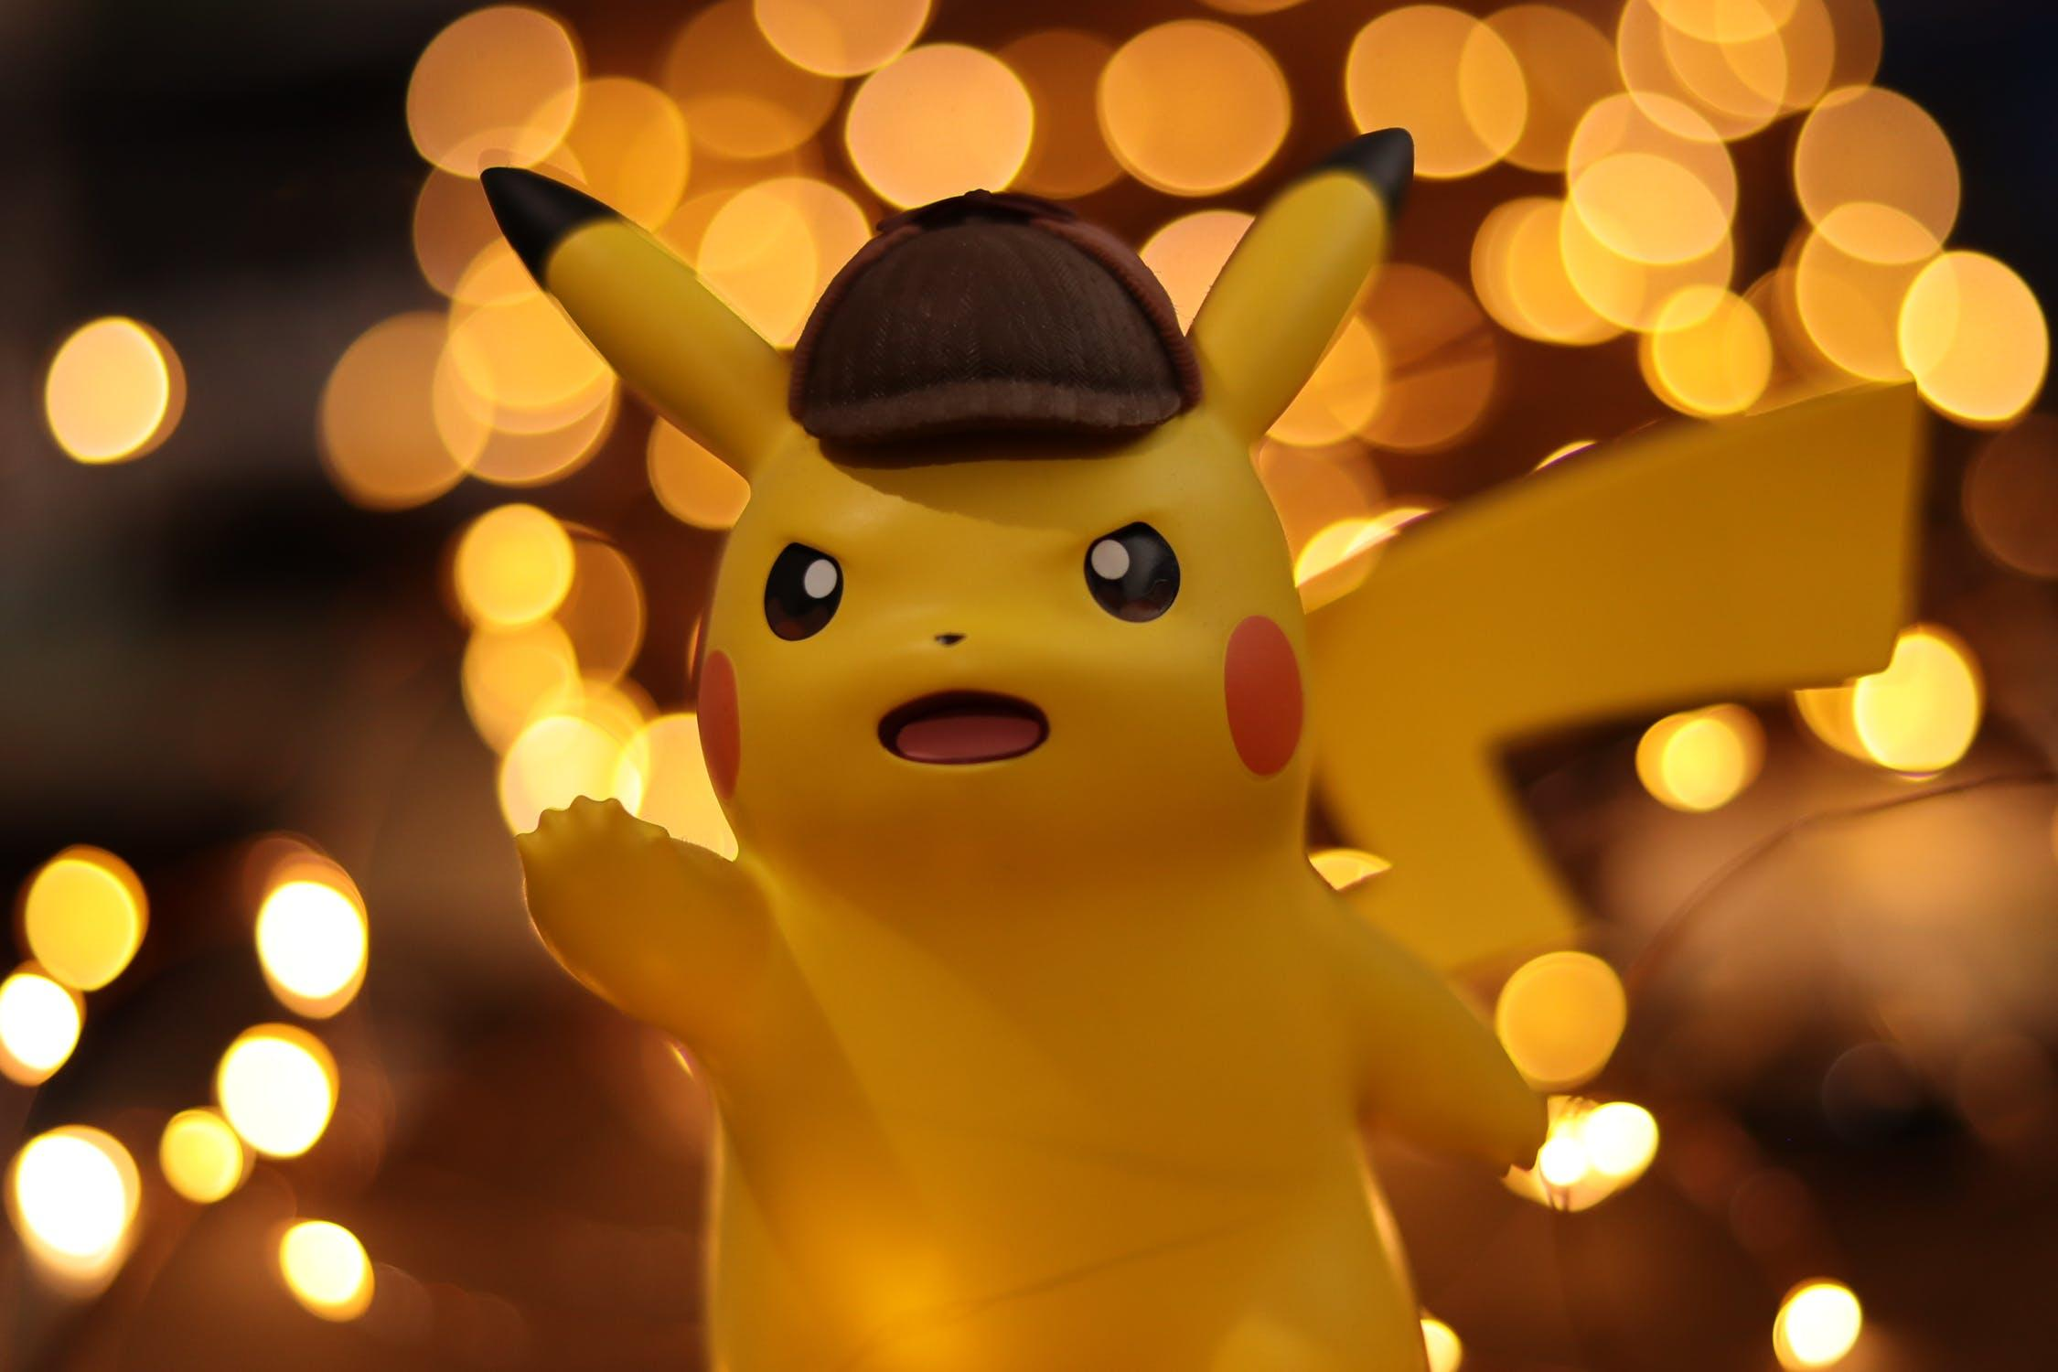
Notes:
Those entities are Pokemon

Slide 6
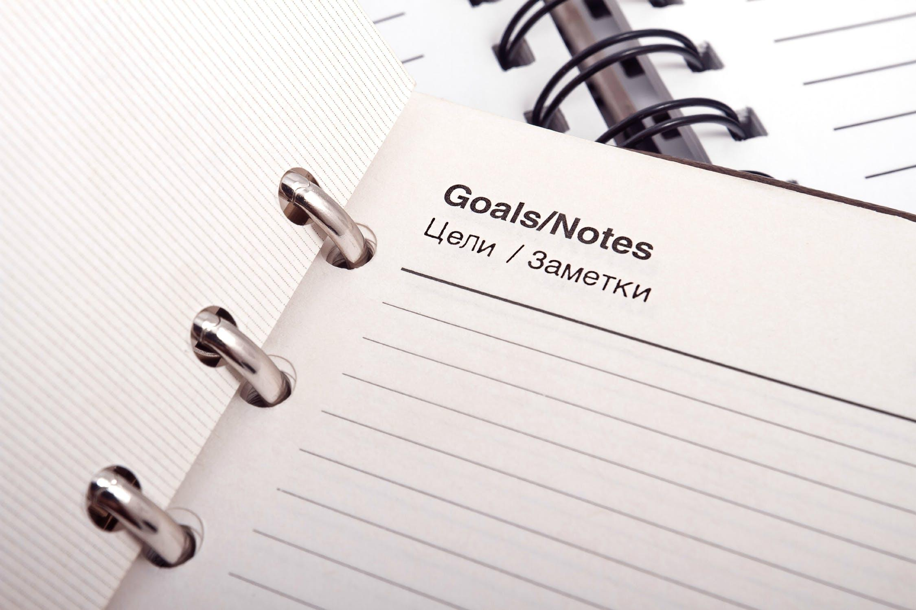
Create the Slackbot Pokedex
@Slackedex
Notes:
What is our goal?
To create a slackbot that will allow anyone to ask for the name of a Pokemon based on a description or many characteristics.

Slide 7

Road Blocks
Users… ugh
# of Pokemon
Text Processing?!?
Handle updates?
MVP
Time
Notes:
- We don't know how are users are going to ask for information
- We don't want to build logic around every Pokemon
- We need to process raw text from Slack
- We want to be able to add new Pokemon or our knowledge base without much work.
- We want to make an MVP quickly, and cover edge cases as they arrive.

Slide 8

Notes:
This is a hard problem to solve
Looking at it from a different view might help, clear the clouds.

Slide 9

Notes:
The user’s point of view to be more precise

Slide 10

Examples
@Slackedex Who is the pokemon that appears before a natural disaster?
@Slackedex What is the name of the baby electric mouse Pokemon?
@Slackedex Who are the legendary bird Pokemon?
Notes:
Here are some examples of what a user might type into slack
Knowing we are making a slackbot for other we want to lock it down to @mentions
This is to prevent the bot answering when not directly pinged. What does this really look like?

Slide 11
Examples
<@U024BE7LH> Who is the pokemon that appears before a natural disaster?
<@U024BE7LH> What is the name of the baby electric mouse Pokemon?
<@U024BE7LH> Who are the legendary bird Pokemon?
Notes:
This is what we will see as the message text from Slack.
Thinking about the problem the first thing we can do it remove the mention to the bot.

Slide 12
Examples
Who is the pokemon that appears before a natural disaster?
What is the name of the baby electric mouse Pokemon?
Who are the legendary bird Pokemon?
Notes:
@mention has been removed What next?

Slide 13
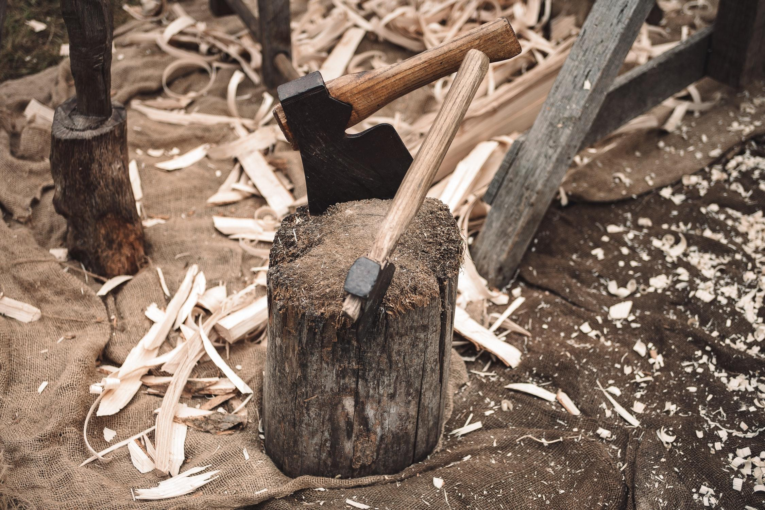
Notes:
These lines of text are to big to process
We need to chop them up into smaller pieces
What can do this?

Slide 14
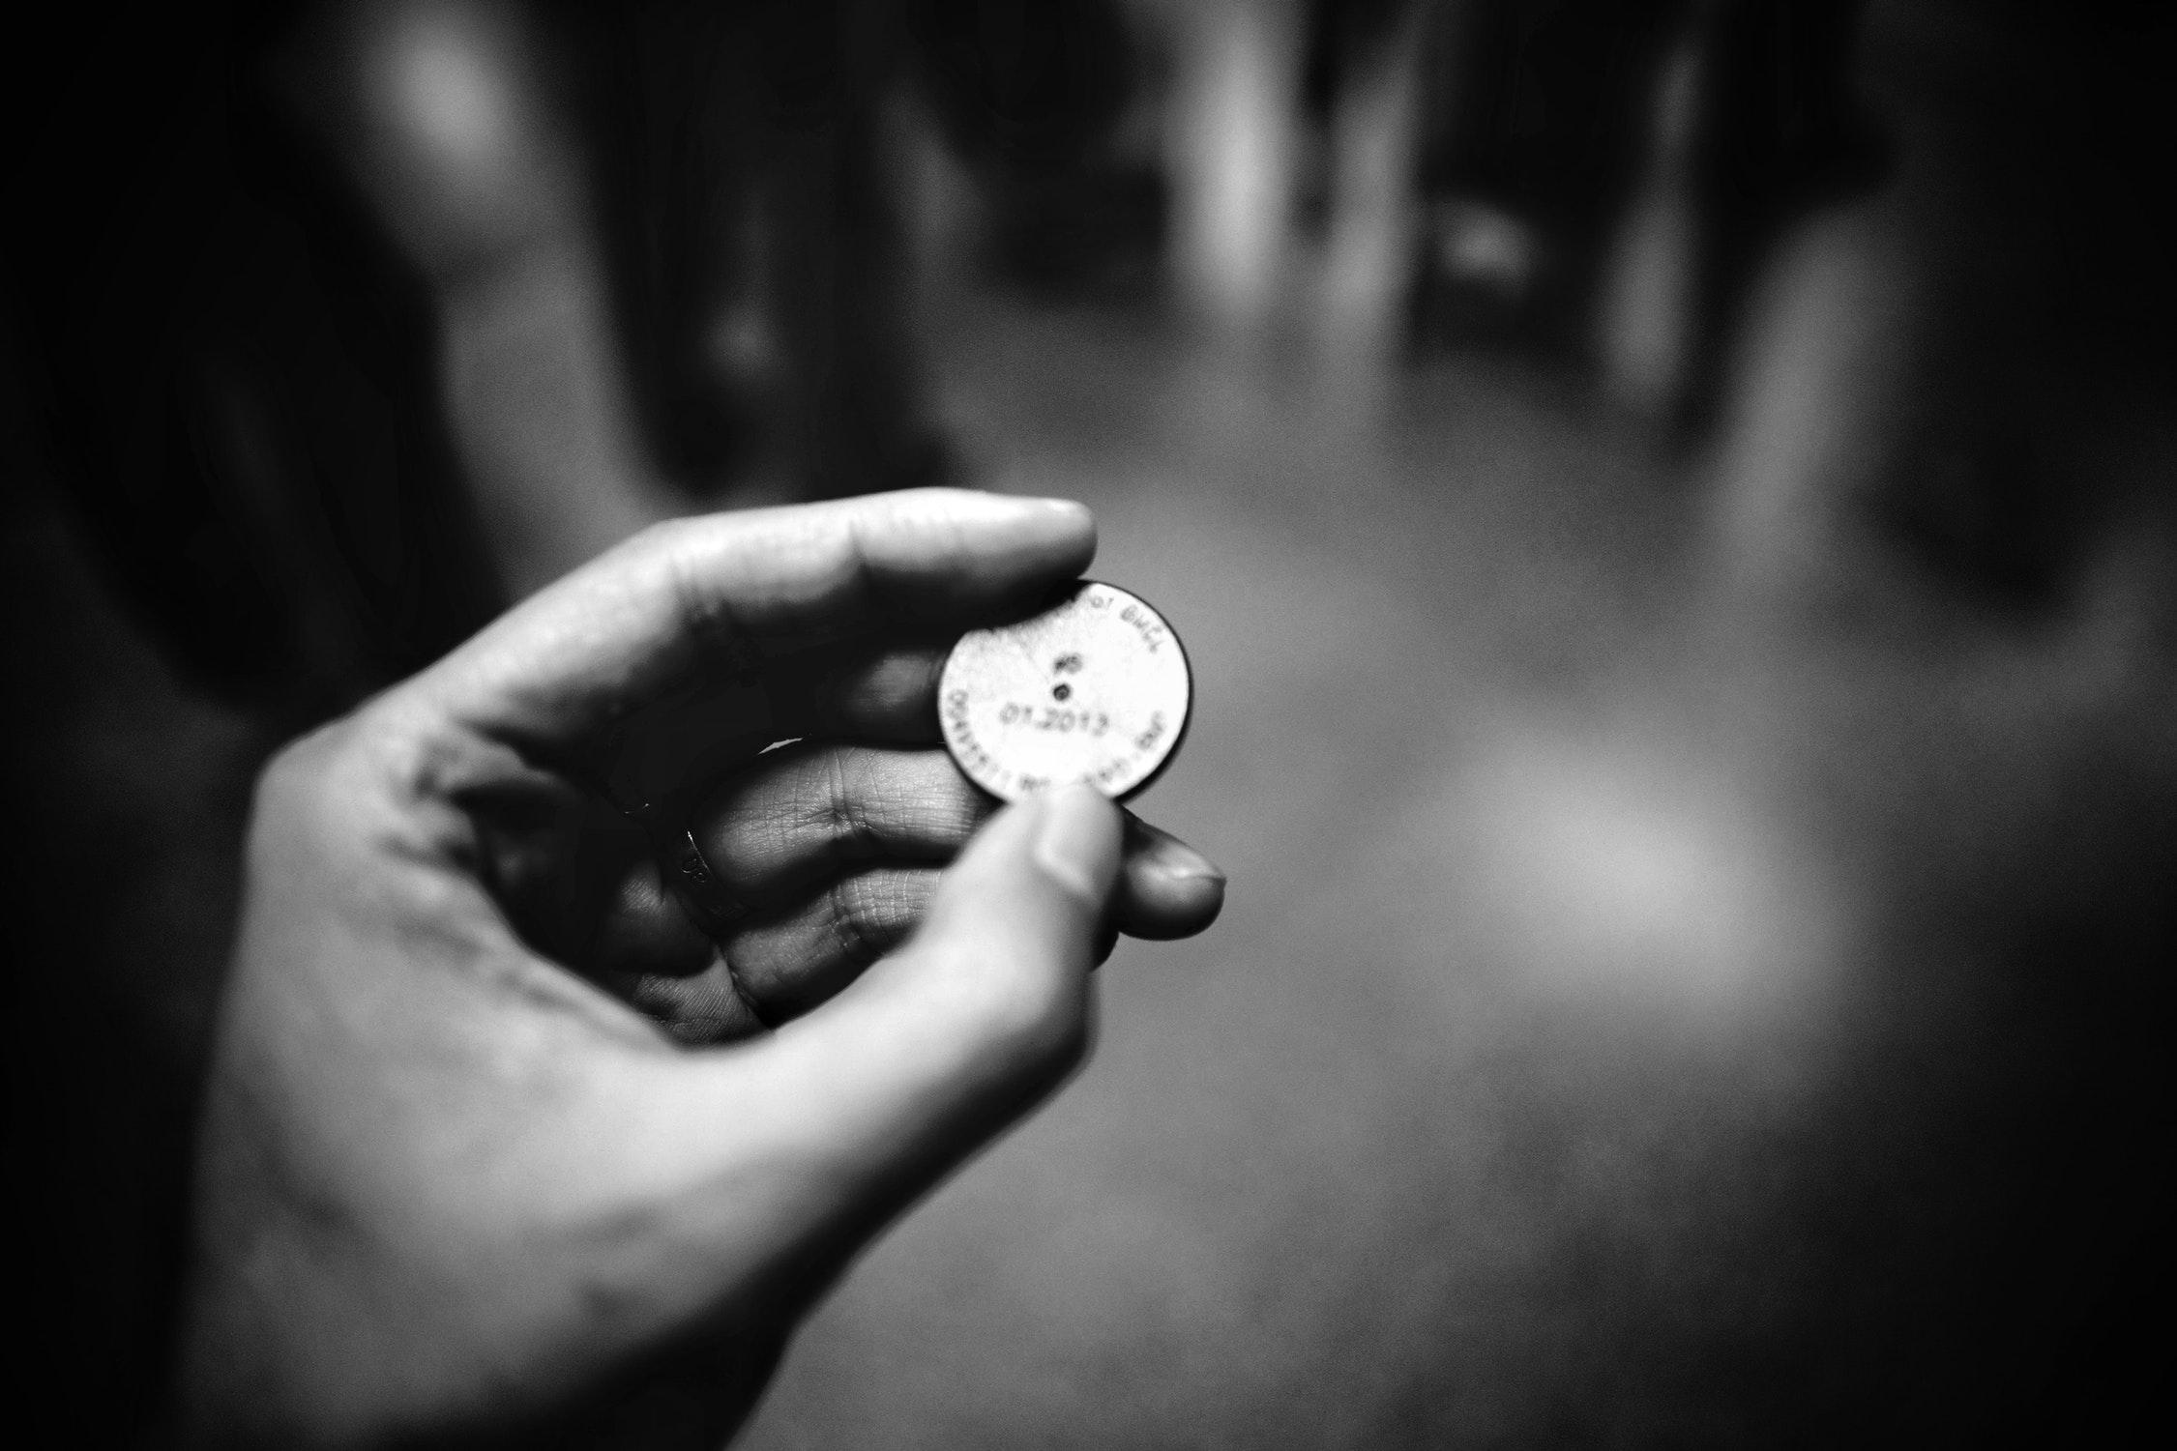
Tokenizer
Notes:
We need a Tokenizer
These are processes that break up string into arrays of tokens
Many different Tokenizers exist
Word (which we will be using)
Character
Sentence
Punctuation
Pattern (Regex)

Slide 15
Examples
Who is the pokemon that appears before a natural disaster?
What is the name of the baby electric mouse Pokemon?
Who are the legendary bird Pokemon?
Notes:
Now we are going to apply the word Tokenizer

Slide 16
Examples
[ 'Who', 'is', 'the', 'pokemon', 'that', 'appears', 'before',
'a', 'natural', 'disaster' ]
[ 'What', 'is', 'the', 'name', 'of', 'the', 'baby', 'electric',
'mouse', 'Pokemon' ]
[ 'Who', 'are', 'the', 'legendary', 'bird', 'Pokemon' ]
Notes:
Now we have applied the Tokenizer and have our array of tokens.
What is next
Many of these words have various versions or inflexions (example: appears, appearing, appeared)
We want to reduce these variations to work with a smaller dataset
Reducing the variations could lower the correctness of the solution
How can we reduce these variations?

Slide 17

Stemmer
Notes:
Here enters a Stemmer These processes bring a word closer to it's normalized root word known as a lemma
A simple way to do this is to remove the common morphological and inflexional prefixes and suffixes. Porter / Lancaster Stemmers
But..

Slide 18
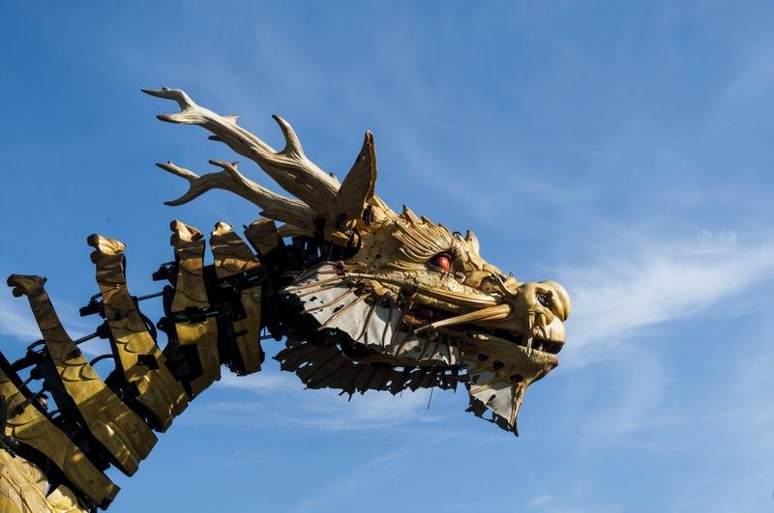
Lazy / Laziness = Lazi
Notes:
Here be dragons These simple algorithms however can be prone to error
Due to simplifying words to root word that is different than the root in the language

Slide 19

Notes:
Today we will be using the Porter Stemmer algorithm which is one of the simpler algorithms

Slide 20
Examples
[ 'Who', 'is', 'the', 'pokemon', 'that', 'appears', 'before',
'a', 'natural', 'disaster' ]
[ 'What', 'is', 'the', 'name', 'of', 'the', 'baby', 'electric',
'mouse', 'Pokemon' ]
[ 'Who', 'are', 'the', 'legendary', 'bird', 'Pokemon' ]
Notes:
Now lets stem these words using the Porter Stemmer

Slide 21
Examples
[ 'Who', 'is', 'the', 'pokemon', 'that', 'appear', 'befor',
'a', 'natur', 'disast' ]
[ 'What', 'is', 'the', 'name', 'of', 'the', 'babi', 'electr',
'mous', 'Pokemon' ]
[ 'Who', 'ar', 'the', 'legendari', 'bird', 'Pokemon' ]
Notes:
Now that we have applied the Stemmer we can see some of the words have changed.
But, can we do more?
Many words here do not hold much contextual meaning
What is we remove them.

Slide 22
Examples
[ 'pokemon', 'appear', 'natur', 'disast' ]
[ 'name', 'babi', 'electr', 'mous', 'Pokemon' ]
[ 'legendari', 'bird', 'Pokemon' ]
Notes:
This is a much nicer list to process.
Shorter
Contextual
Void of word variations
But...

Slide 23
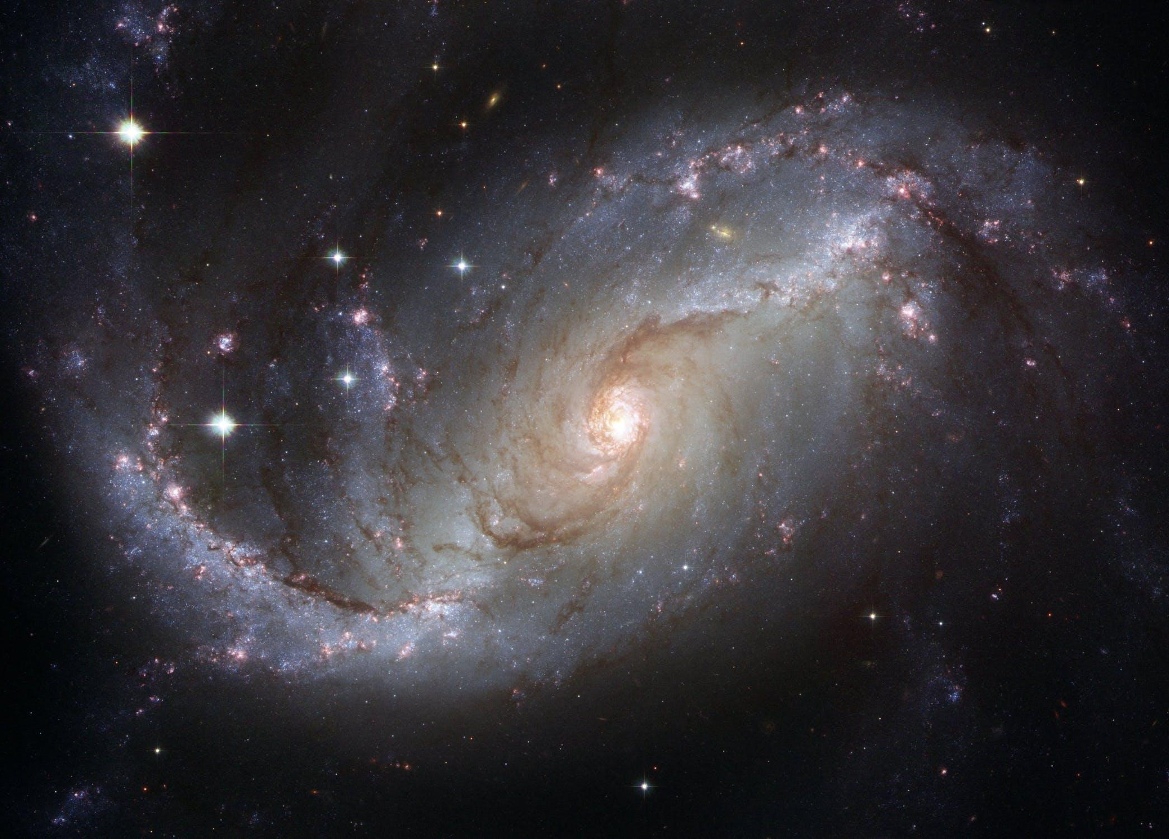
Notes:
I have to ask, is there something else out there that can do this for us
I mean is there something already created that will cover the majority of our use case and provide the same or more functionality?

Slide 24
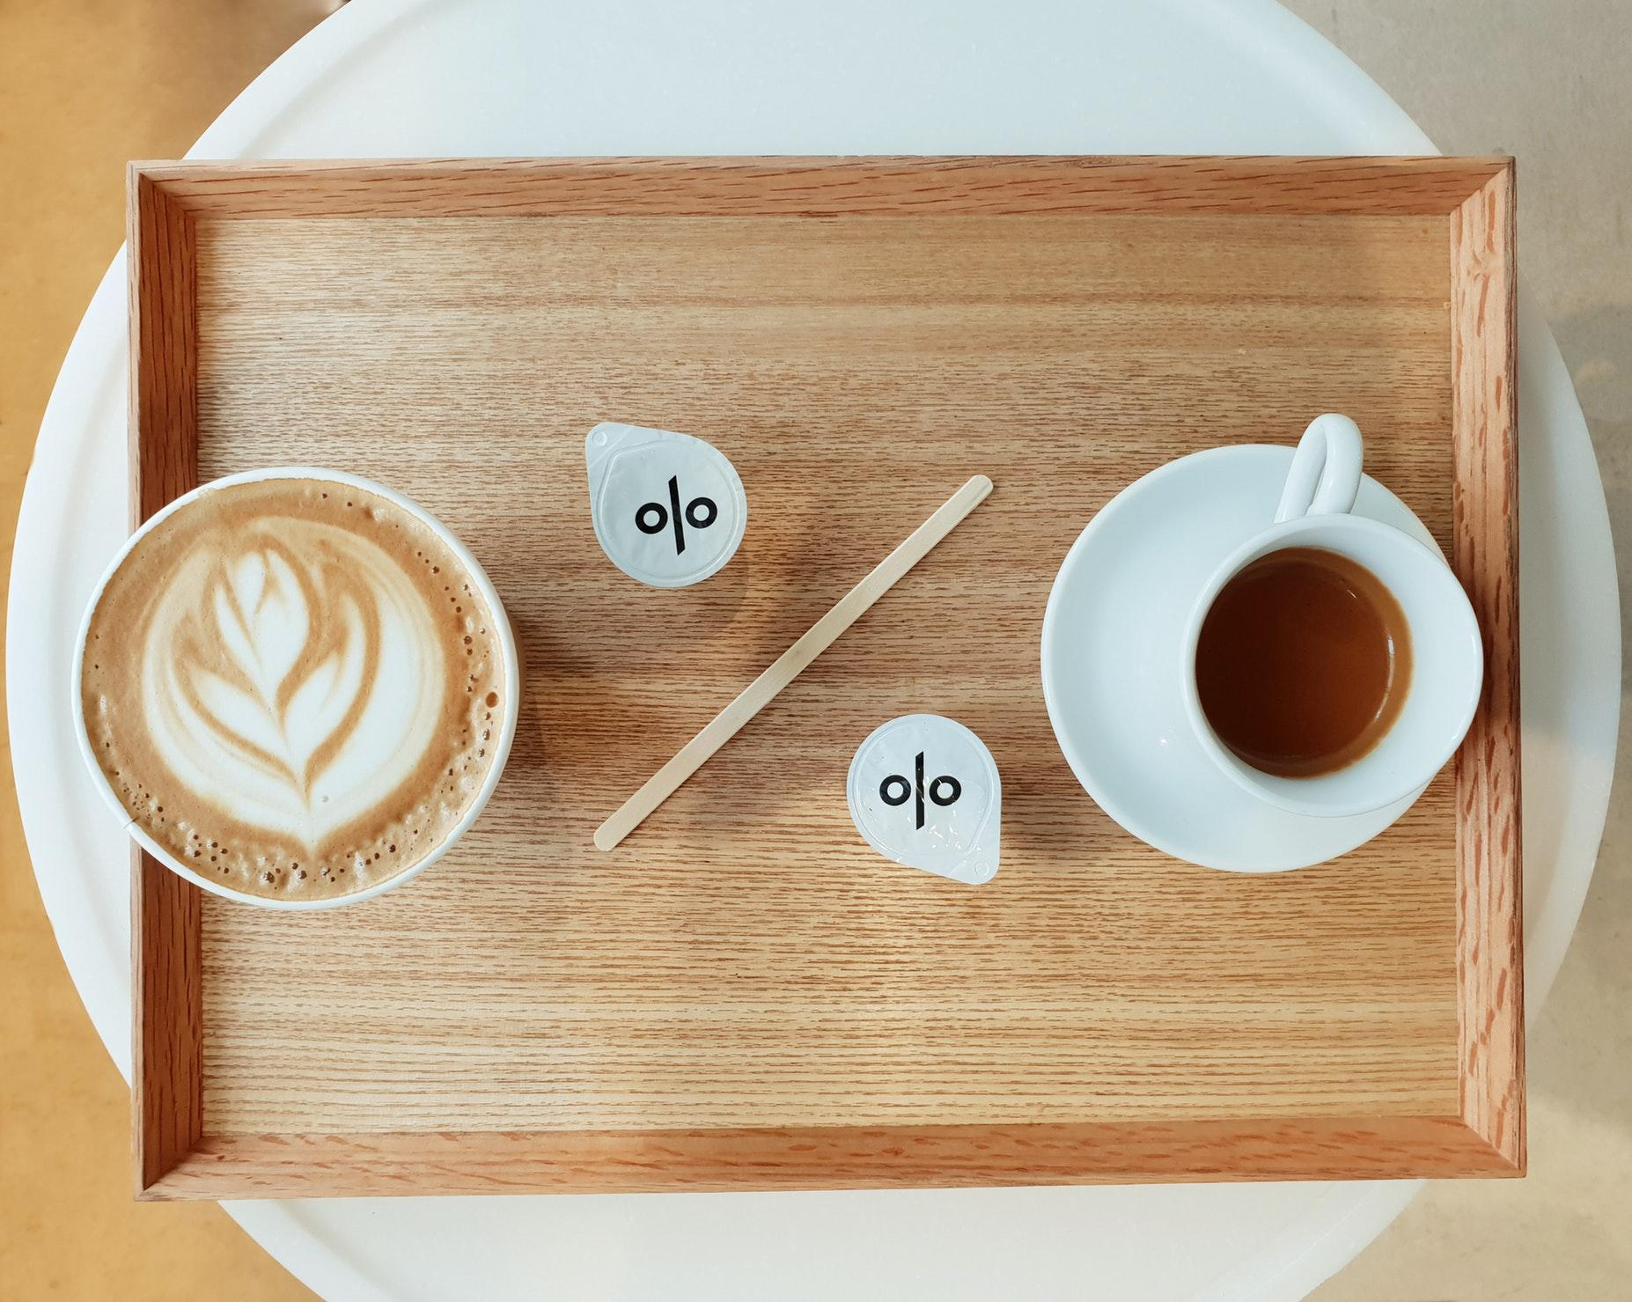
Notes:
What is the other thing
Can provide you the probability that
our original sentences match a predefined something

Slide 25
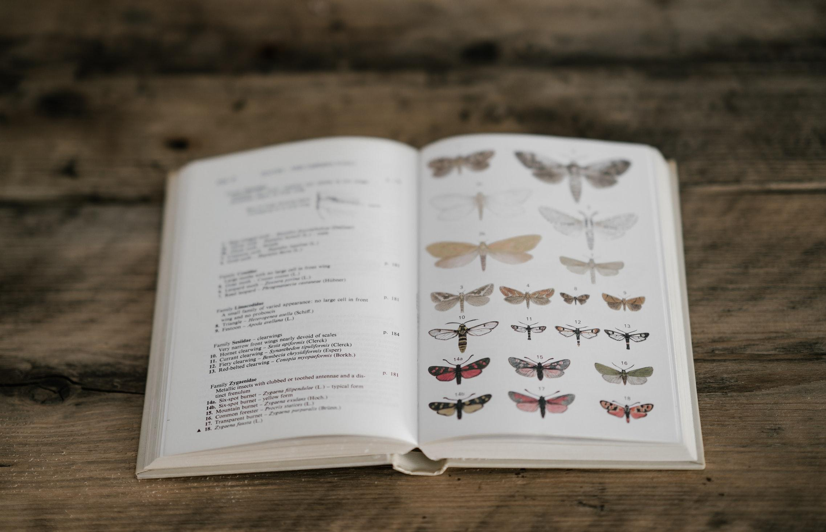
Classifier
Notes:
A classifier does everything we talked about so far today
More specifically the library we are doing also preprocesses text in our classifiers
There are many different Classifiers (examples Naive Bayes & Logistic Regression)
We will be using Logistic Regression

Slide 26
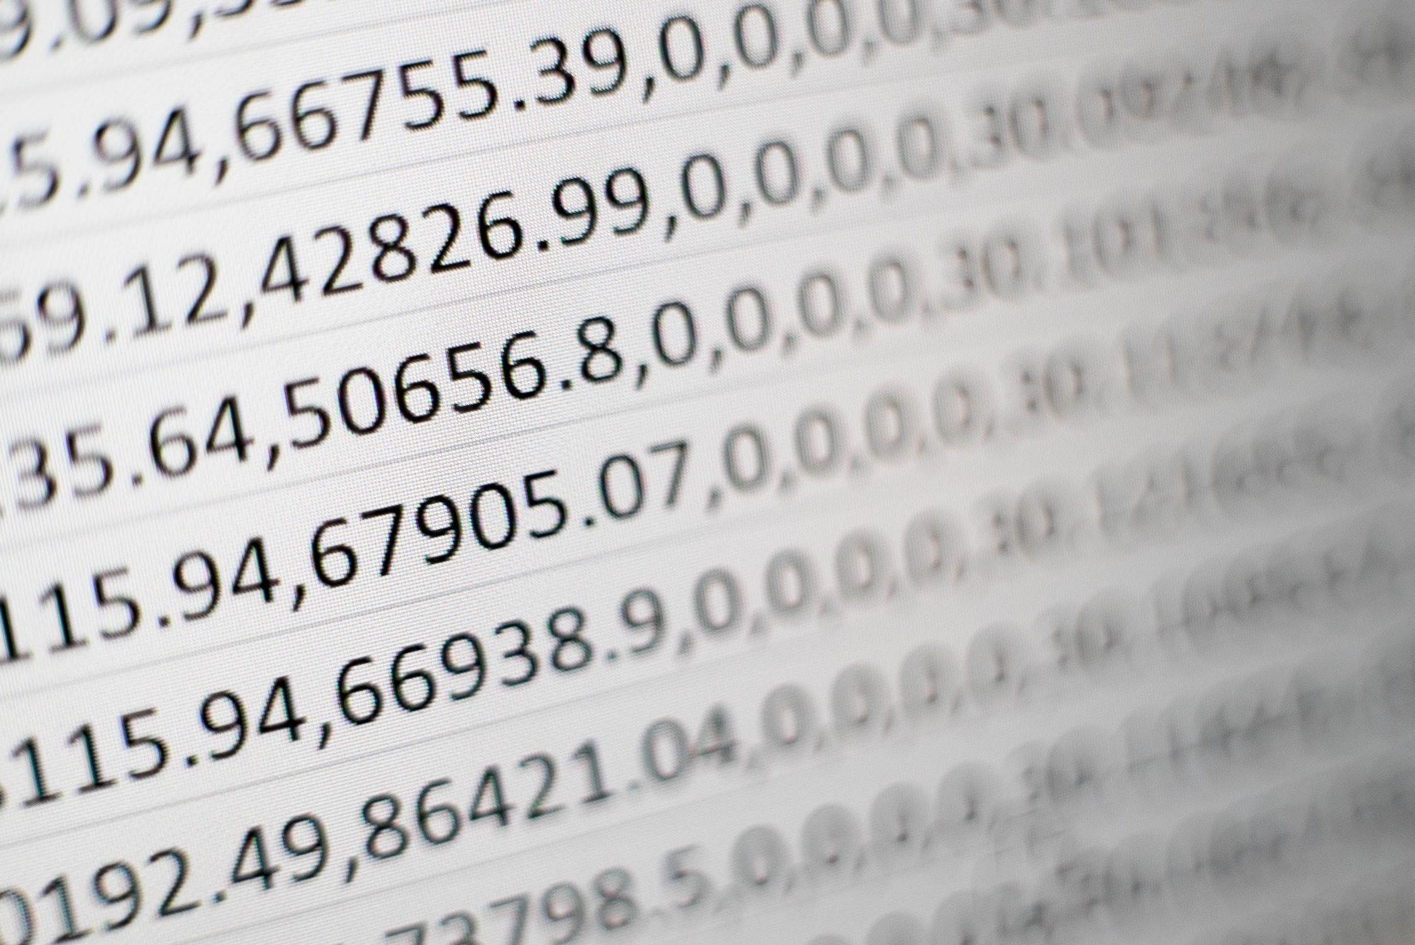
Notes:
This is a widely used statistical model, that models the probability output based on it's input.
Classifiers need to be trained with a data set prior to use
Once trained, we can provide the classifier with our original input text
Then it will return probability that the original text is classified matching one of training cases
The probability will be a number between 0 and 1

Slide 27
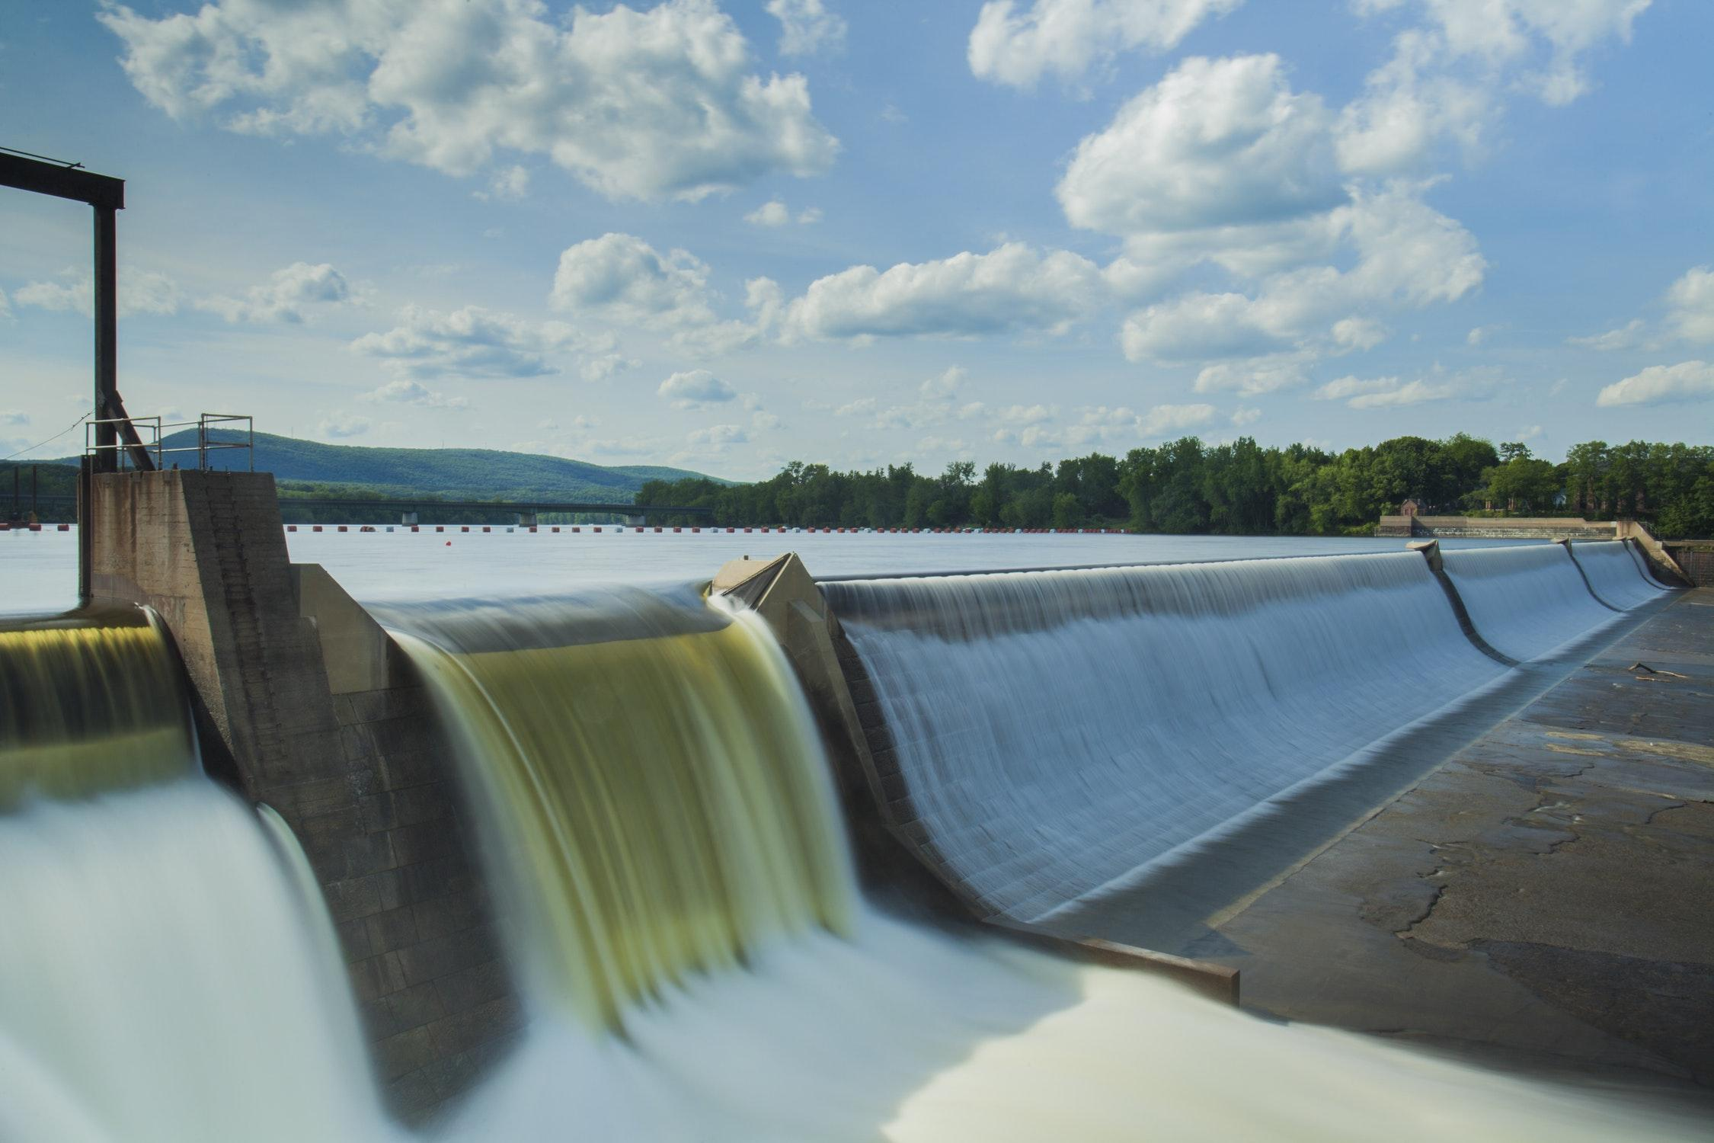
Notes:
Since we are working with a numeric probability we need to define a Threshold.
For example we are are looking for classifications with a 95% or higher probability of being correct.
Thresholds are something that you will need to play with and will change based on your training set.

Slide 28

Drawbacks
Notes:
Classifiers require training
You will need data ahead of time for training
Accuracy of your classifications depend on the amount of training data
Won’t be able to handle every case
Training data might have to be sorted or transformed before added to the classifier

Slide 29


How?
NodeJS (version 10.x.x +)
NPM Packages
@slack/rtm-api
@slack/web-api
natural
Notes:
NodeJS
Chosen because the majority of the team is the space at Bayer I work use Node.
The original Slackbot was built to be extended by any team
NPM Packags

Slide 30
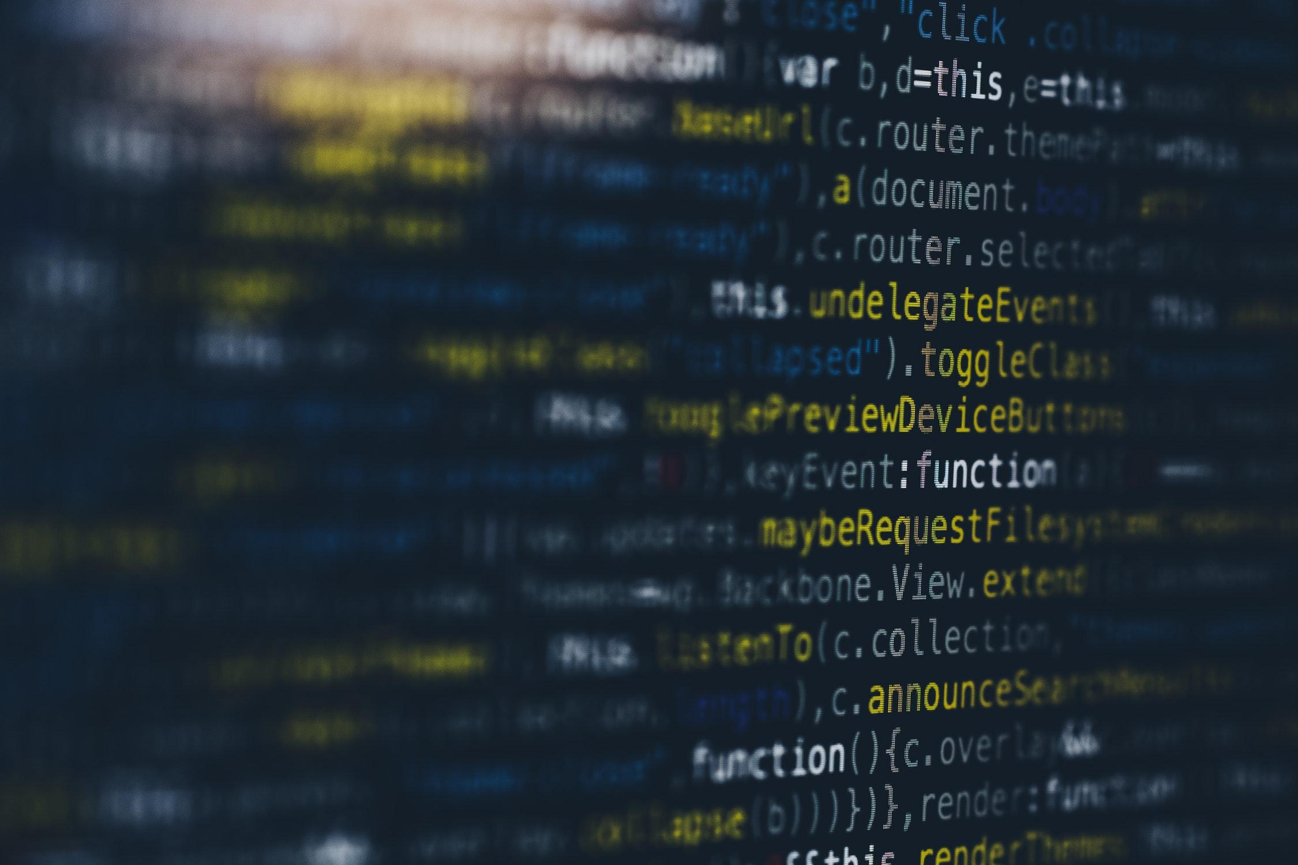
Coding Time
github.com/cmarfia/slackbots-from-commands-to-conversations
Notes:
Walk through the codebase
- index.js
- config.js
- classifer.js
- process-message.js
- dao/
- pokemon.js
- data/
- …
Follow TODO’s

Slide 31

to summarize
@Slackedex
PreProcessing
Tokenizers
Stemmers
Classifiers
Notes:
- We wanted to build a Slackbot that can provide the name of a pokemon based on a description or characteristics.
- There is a lot of pre-processing you can do to text to make it easier to work with.
- Tokenization is the act of separating text into an array of tokens
- Stemming converts words into their normalized root word, which reduces the total possible number of words used in your analysis
- Classifiers can take that a step further and provide a the probability that an input text matches text from our pre-defined model.
- This all can be done in a language most of us are already familar with, which is JavaScript

Slide 32

Notes:
Are there any questions

Slide 33

Notes:
Thank you everyone for coming

